Slide 1
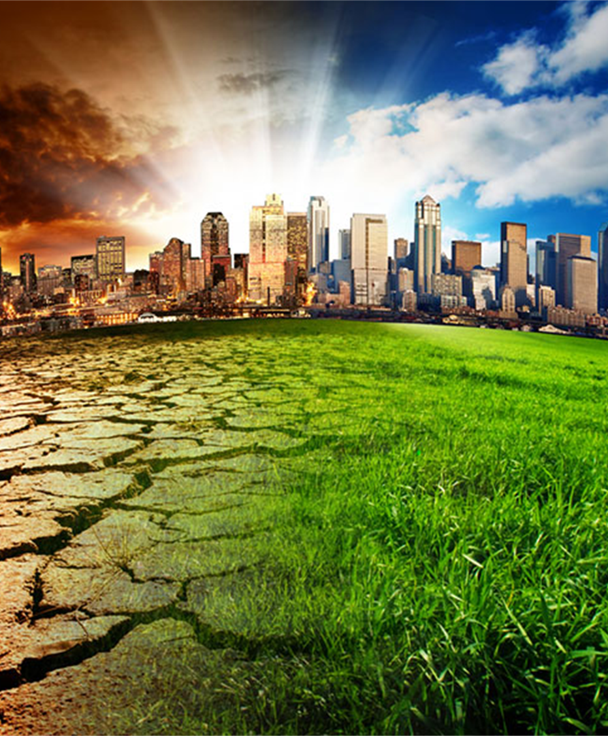
Climate Change: Making It Personal
Team Cowboys – Final presentation
Jason Pinto, Ron Maxseiner, Kristina Longe, Sai Kadambari, Brian Monter
May 11th, 2022

Slide 2

The Problem
What are the things that impact climate change the most? How can we help?
We will focus on analyzing and modeling data related to surface temperatures to see if we can determine trends in the surface temperatures. From there, we will try to predict surface temperatures while making our insights accessible and useful to localities, organizations, and the general public.

Slide 3
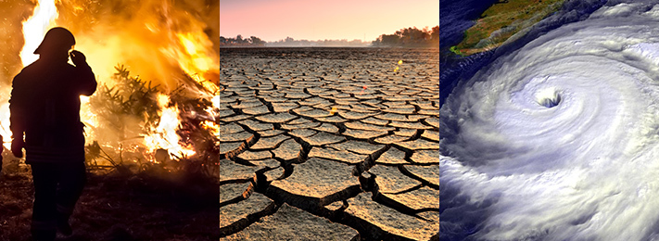
Background & Rationale
What is Climate Change?
What impacts Climate Change?

Slide 4
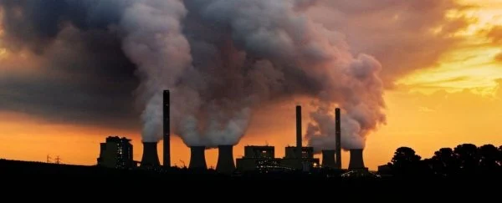
Project Objectives
What trend(s) can we observe in the data?
Can we predict a range/distribution of surface temperatures? How?
How can we present the results so that they are useful to our readers?
How do fossil fuels impact surface temperature change?

Slide 5
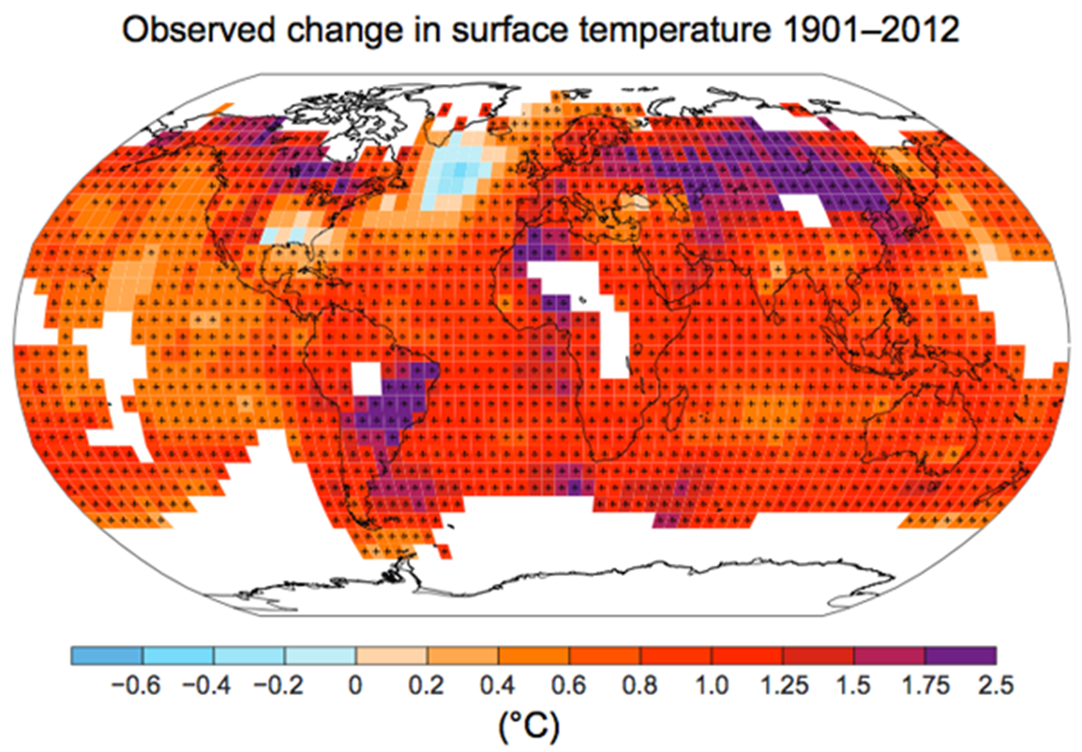
Problem Space
Why is this a problem worth solving?
What data are we using to solve the problem?
What analytical tools will help us solve the problem?

Slide 6
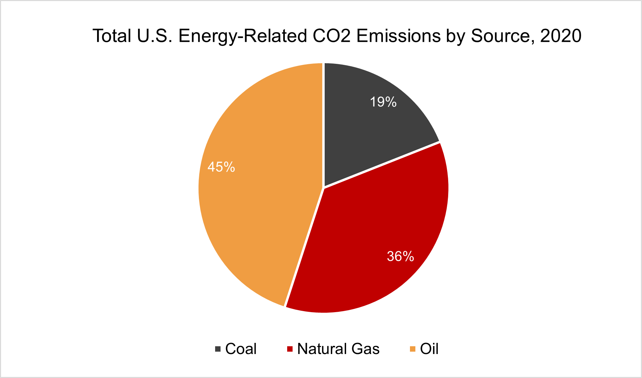
Dataset overview
Two datasets;
Climate Change: Earth Surface Temperature Data | Kaggle
Global Land Temperatures By City (main dataset)
Global Temperatures (main dataset)
Consumption in the world of fossil fuel | Kaggle
How do they help solve our problem?

Slide 7
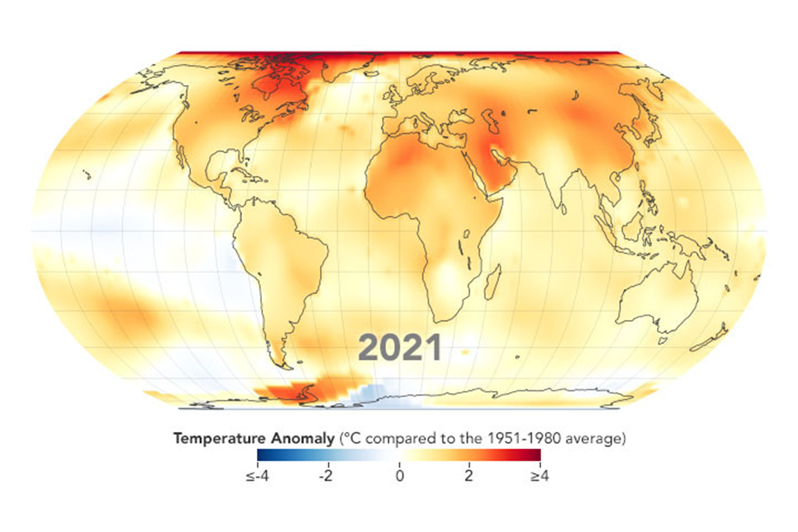
Field Descriptions – Surface temperature dataset
Date
Average Temperature
Average Temperature Uncertainty
City
Country
Latitude
Longitude

Slide 8
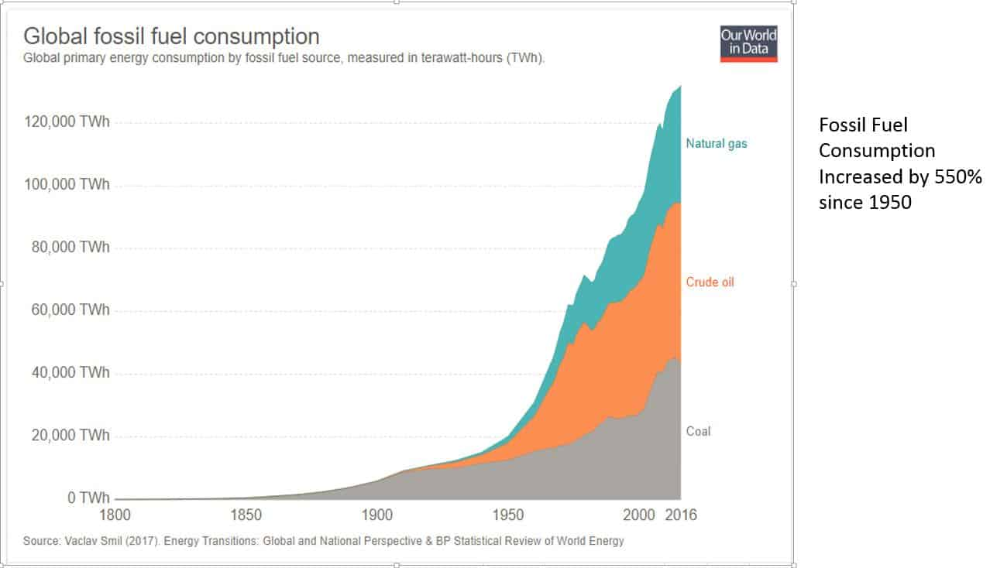
Field Descriptions – Fossil Fuel Dataset
Entity (State)
Code
Year
Entity (Country)
Annual Change in Fossil Fuels
Annual Change in Coal
Annual Change in Oil
Annual change in Gas
Region (Continent)
Sub-Region

Slide 9
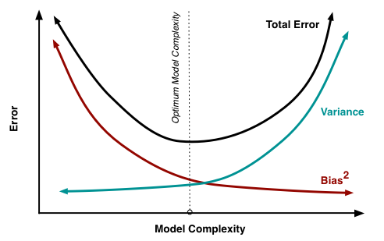
Algorithm 1 description
Ridge Regression
Global – Yearly – Ridge/ElasticNet
Country – Yearly – Ridge/ElasticNet
Predict Average Temperature Using Fossil Fuel Data

Slide 10
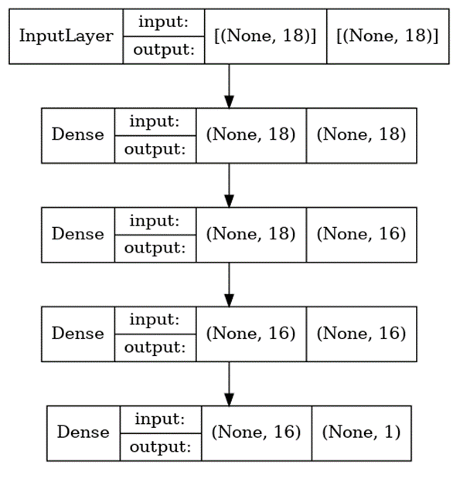
Algorithm 2 description
Artificial Neural Networks
Global – Yearly – Ridge/ElasticNet
Country – Yearly – ANN
Country – Monthly – ANN
City – Monthly - ANN
Predicting Average Temperatures Based on Month and Physical Location

Slide 11
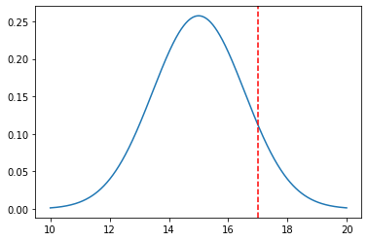
Visualization 1
Probability Distribution Function
Distribution of predicted temperatures based off historical temperatures and highlighting where the current temperature falls in that range.

Slide 12
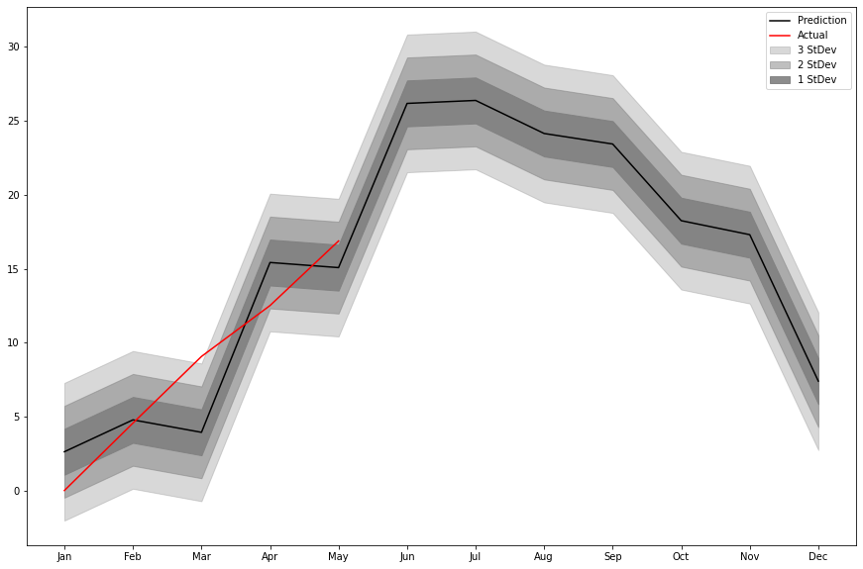
Visualization 2
Line Graph
Predicted and actual values for temperature in Fairfax, VA

Slide 13
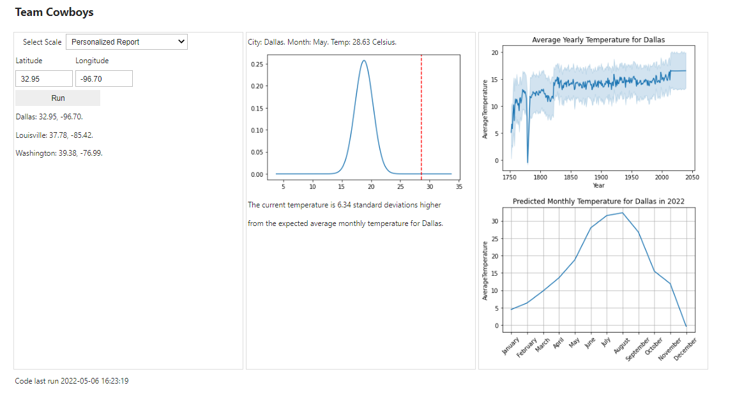
The App
App based on previous visualizations
Retrieved location based data from a web service
Saved data and models to be used inside the App
Translated the visualizations into widgets
Added UI to allow the users to select location and parameters

Slide 14
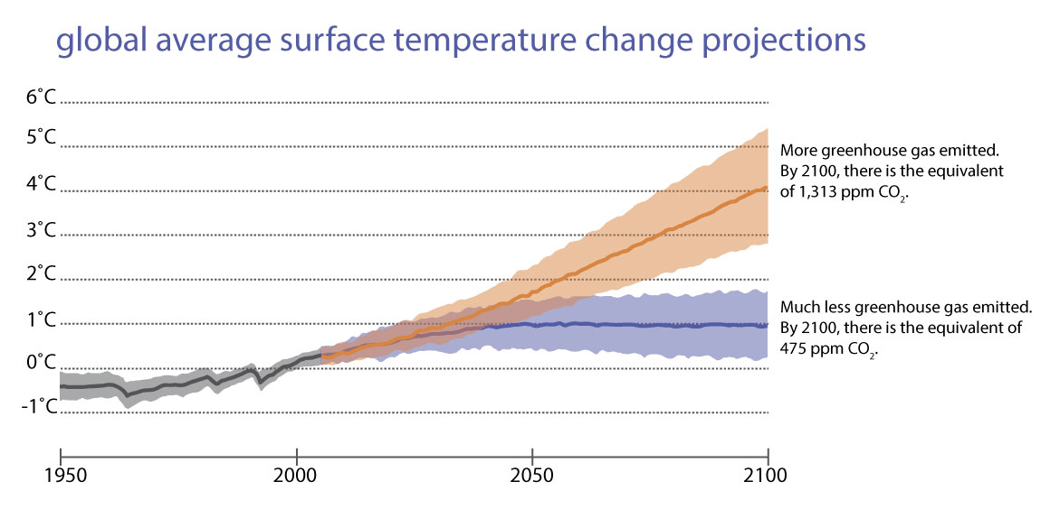
Findings/Results
Temperature is hard to predict -> Other data is needed
Ridge Regression was a moderately strong predictor
Artificial Neural Network was a strong predictor
Compared to others -> in between max and min predictions

Slide 15
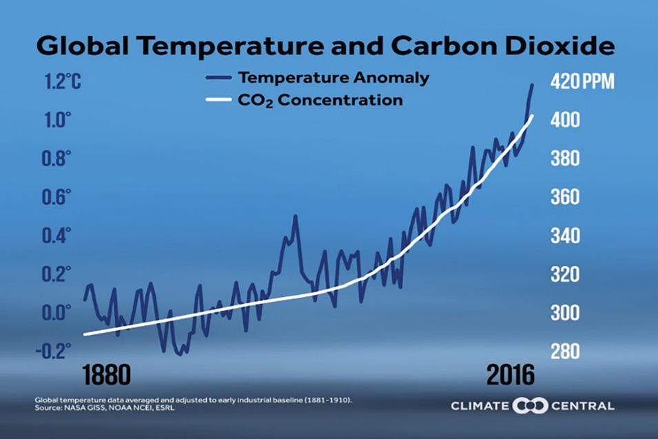
Future Work
Consider other variables
Utilize the real time data more
Full set of cities/locations
Collinear Data – How much do the variables impact one another?

Slide 16
References
Effects | Facts – Climate Change: Vital Signs of the Planet (nasa.gov)
Mitigation and Adaptation | Solutions – Climate Change: Vital Signs of the Planet (nasa.gov)
You say 'global warming', I say 'climate change' | Macmillan Dictionary Blog
An Earth Scientist's Perspective on Climate Change (aapg.org)
Ridge Regression for Better Usage | by Qshick | Towards Data Science
Six Questions to Help You Understand the 6th Warmest Year on Record – Climate Change: Vital Signs of the Planet (nasa.gov)
Climate Change, Fossil Fuels, and Human Well Being - Competitive Enterprise Institute (cei.org)
Over 1 Million People Died in 2017 From Fossil Fuels Being Burned, Study Finds (sciencealert.com)
SOTC: Introduction: Are Global Temperatures Rising? | National Snow and Ice Data Center (nsidc.org)
Fossil Fuels | EESI
Predictions of Future Global Climate | Center for Science Education (ucar.edu)

